Slide 1
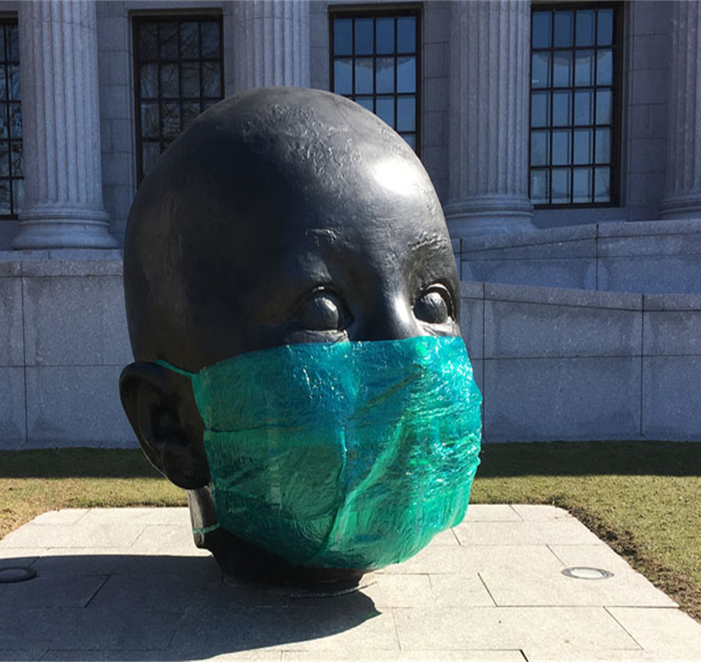
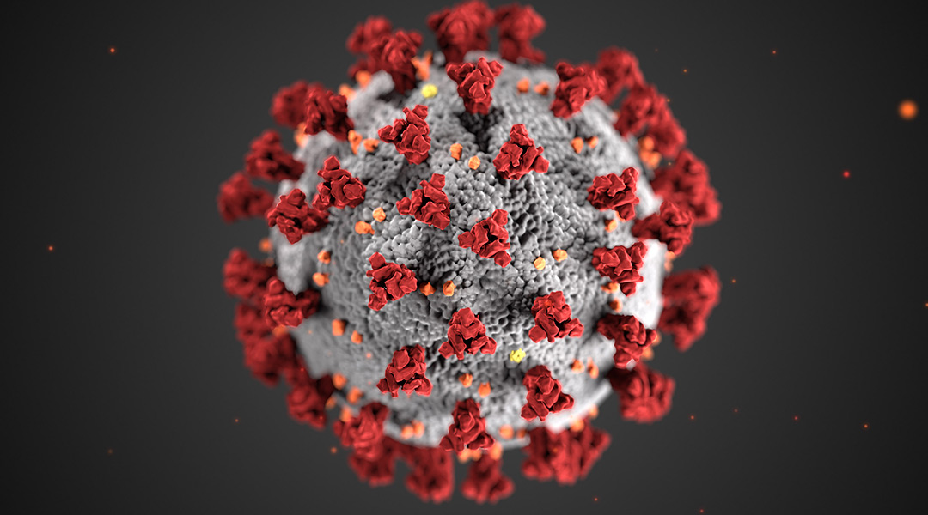
Covid - Births
By: Milton Francis

Slide 2
Agenda
Theory
Childbearing age
Seasons
Conception
Comparison between States during the winter season
Sources

Slide 3
Theory
Does it feel like many friends and family members announce the pending arrival of a baby during the fall and winter months? That’s not exactly a coincidence. It turns out the cold season is associated with more reproductive activity than any other time of the year.
Questions:
Is there a correlation between the temperature and the number of babies being conceived?
In the winter, does warmer temperature states conceive more than colder temperature states?
How did COVID affect the conception rate

Slide 4
Childbearing Age
Healthy reproductive age is from 15- 44 years old
By 45, fertility has declined so much that getting pregnant naturally is unlikely for most women
After 44, the chances of having a stillbirth or a child with Down syndrome skyrocket.

Slide 5
Seasons
There are four seasons, Spring, Summer, Fall and Winter but the two we will focus on is Summer and Winter
Summer
June, July and August
Winter
December, January and February

Slide 6
Conception
How we determine how many babies was conceived during a particular season
Determine the months of that season
Add nine months to the 1st date of the season and nine months to the last day of the season to get the Due date range (or use a conception data calculator)
By working backwards, we can have a great estimate on the conception amount for that season.

Slide 7
Conception
Summer months
June, July and August
Due date range from February 22nd to May 24th
Winter months
December, January and February
Due date range from August 24th to November 21st

Slide 8
Comparison between States during the winter season
Criteria:
COVID years – 2017, 2018 and 2019
Temperature
Population

Slide 9
COVID YEARS
2017, 2018 and 2019
Pre COVID
2020
COVID

Slide 10
Sources
When covid started: https://www.cdc.gov/museum/timeline/covid19.html
Due date calculator: https://www.whattoexpect.com/due-date-calculator/
Weather: https://www.ncdc.noaa.gov/cag/statewide/mapping/110/tavg/201901/4/value
Childbirth by state: https://wonder.cdc.gov/

